Slide 1

Smart Shopping Using IOT
BMS College of Engineering
Department of Information Science and Engineering
CAPSTONE PROJECT PHASE -1
Review - II
Batch No:-
Project Team Members:
Prajwal Kulkarni - 1BM18IS067
Pramila Dalavai - 1BM18IS068
Samarth M Hathwar- 1BM18IS088
Under the Guidance of
Dr./Prof. Guide Name
Sindhu K
Department of ISE

Slide 2
Agenda
Introduction
Motivation
Literature Survey
Objective
Proposed System
System Requirement Specification
System Design
Detailed Design
Conclusion
References

Slide 3
Introduction
In a typical shopping mall, the crowds are frequently large, especially during festival season, and billing time will grow proportionately.
As a result, the smart shopping system's primary goal is to lessen shopping time.
Customers can create their own invoices, making it simple for them to estimate their bill.
Smart shopping can also help in eliminating manual labor.
This strategy can help you save money, and the money you save can be used to improve the quality and experience of your customers.In addition, instead of counters, more products can be placed.

Slide 4
Motivation
We've seen long lines in supermarkets that take up the majority of our time.
Consumers encounter numerous issues while shopping, such as the fear that the amount of money brought is insufficient. As a result, we may present the cost using this smart purchasing system.
The investment, manpower, and supermarket occupancy will all decrease for the supermarket owner.
It encourages people to shop in supermarkets.

Slide 5
Existing System
1) The traditional barcode system is currently in use at supermarkets and shopping centres.
2) The drawback of such a system is that it can only scan a single product at a time. During the billing procedure, this takes a long time.
3) As a result of our effort, we have discovered a superior solution that aids in effective time management and bill generation at checkout.

Slide 6
Literature Survey
SL.NO | Title of the Paper | Problem Addressed | Authors Approach / Method | Results
1 | Applications on Secure Smart Shopping System -Suhas B.M1, Tanu.N.Prabhu2 | The existing system of shopping is a long process and consumes lot of time like choosing the products, waiting in the queues, scanning the products and checking out. | 1)The cart is equipped with sophisticated microcontroller and sensors which reduce the time in billing as it would be scanning the items instantly when the item is added to the cart 2)This would totally eliminate the queues in the shopping centres. | Sensors and microcontrollers is easily available at a very cheap rate and could be equipped to each and every cart. It also focuses on security aspect, by ensuring that the payment has been processed before exit.

Slide 7
Literature Survey
SL.NO | Title of the Paper | Problem Addressed | Authors Approach / Method | Results
2 | IoT Application on Smart and Secure Shopping System using RFID, ZigBee and Gossamer Protocol. -Purva S. Puranik1 , Parikshit N. Mahalle2 | Security: The communications between server and other entities of smart shopping system should be resistant to any eavesdropper who actively monitors the traffic. | 1)The security is implemented using cryptography. 2)Symmetric keys are generated for every request response cycle. And before processing any data, validation is performed via message authentication code(MAC). 3)The messages are encrypted using Gosammer algorithm. | The proposed secure smart shopping system utilizes RFID technology, Zig-Bee technology as well as the Gossamer protocol. By doing so, the departmental stores will also benefit by fast and secure inventory, improved customer service, etc.

Slide 8
Literature Survey
SL.NO | Title of the Paper | Problem Addressed | Authors Approach / Method | Results
3 | SMART SHOPPING TROLLEY USING RFID P.T. Sivagurunathan# -. Seema*, M. Shalini*, | The traditional barcode scanner would be able to scan only one item at a time, and it also requires the product to be placed in line of sight with the scanner. | 1)This paper shows the advantages of using RFID tags over barcodes. 2)Using RFID reader it just has to be in the vicinity and it would be detected. Researchers have added a feature to delete the products if it is mistakenly scanned. | Instantly the cart will enable the customers to scan their products and give the bill immediately. Eventually the checkout time is reduced for the customer.

Slide 9
Literature Survey
SL.NO | Title of the Paper | Problem Addressed | Authors Approach / Method | Results
4 | The research of the application of the binary search algorithm of RFID system in the supermarket shopping information identification Ling Wu1,2* , Sheng Liu1 , Baoling Zhao1 , Weinan Wu1,3 and Baozhong Zhu | Currently, the method to solve the problem is time division multiple access (TDMA) [8]. However, due to the special nature of supermarket shopping system, the efficiency of the algorithm is too low. | 1)Binary search algorithm is used to eliminate the problem of collisions. 2)Binary search algorithm refers to a unique sequence code (UID) based on the identification tag. 3)The reader sends a request command to choose a set of labels; If the reader test out the collision, it is necessary to do the next search in a smaller range | Incorporation of this algorithm helps in improved performance and a rapid checkout rate. Helps in faster checkout even if there are large number of items.

Slide 10
Literature Survey
SL.NO | Title of the Paper | Problem Addressed | Authors Approach / Method | Results
5 | Smart Cart For Automatic Billing With Integrated Rfid System -Ravi Kumar 2., Manish Rathore3 , Shivashish Saha4 , Raji C.5 | The existing smart shopping system does reduce the time spent at the billing counters. But, initially it’d take time for the customers to get adjusted to the system on the user experience front. | 1)The researchers have introduced the display unit where it not only displays the cost it also displays the offers and comparison of the other products. 2)Billing unit is introduced where the costumer ends the shopping and navigates to the billing unit and the automated billing is generated and the payment is done. | The main intention of the paper is the model should be user friendly so that even a common person can use the model. The costumer is worrying about the final cost of the things he bought, using this model he can easily estimate his/her total bill amount. Customer can compare the products.

Slide 11
Literature Survey
SL.NO | Title of the Paper | Problem Addressed | Authors Approach / Method | Results
6 | Smart Cart Shopping System with an RFID Interface for Human Assistance Rajeev Ratna Vallabhuni, MIEEE S. Lakshmanachari, G. Avanthi, Vallabhuni Vijay | The clients must set each item, which they need to buy to the truck, and they must sit tight in the long queue for those charging framework. The main idea is to save customers time by providing digital billing system with which the customers can get the bill through their registered Email. | 1)This research work utilizes RFID reader, LCD and Wi-Fi transmitter in the advanced mobile trolley. 2)During the charging section, those Wi-Fi recipients will be utilized to get associated with the machine. 3)RFID occupies the most part tags that are utilized to obtain an exciting ID number of results that utilize radio waves. | RFID TAGS will remain capable of reading/write information, which might be encrypted. By actualizing this RFID organization to the exciting representation of every item that is clinched alongside a showcase, shopping may be carried out in a more effective way.

Slide 12
Literature Survey
SL.NO | Title of the Paper | Problem Addressed | Authors Approach / Method | Results
7 | Robust UHF RFID Based Smart Shopping Trolley Tharindu Athauda , Juan Carlos Lugo Marin, Jonathan Lee, and Nemai Chandra Karmakar, Senior Member, IEEE | PEOPLE used to have a list of items written in a piece of paper when they went shopping for groceries; However, the advancement of technology has changed how people do shopping over the last decade. There have been various attempts which were carried out in the past to eliminate lengthy shopping lines in retail stores. | 1)UHF RFID initiate the Transmission signal 2)signal reach antenna and start transmission 3)Trolly is scanned 4)UHF RFID tag received power from transmission signal and included current to ic on the tag. 5)Tag generates signal with EPC code and transmit through tag antena back to CP antena | Reader received the signal through CP antenna and extract information. Display process information through Graphical User interface to consumer. Update the stock in store inventory.

Slide 13
Literature Survey
SL.NO | Title of the Paper | Problem Addressed | Authors Approach / Method | Results
8 | Arduino enabled IoT based Smart Shopping Trolley R Nithiavathy1 , R Asmitha Shree1 , S Praveen Kumar2 , S Raghul2 | As technology evolves and sees new developments in various fields, including artificial intelligence, machine learning, so on, there are growing customer expectations in world wide web . With the rapidly changing lives, customers have absolutely no time to wait in long lines to do their jobs. Presented shopping method with RFID and arduino controller in this paper. | 1)The trolleys in the shopping centers are a protocol so that they can verify the items placed in them automatically and the last bill is forwarded to a web application, available on any phone or handheld computer. 2)The system is also subject to antitheft management, where the system allows no customer to take unchecked products. | This plan streamlines the payment process and enhances security with RFID technology. This takes the shopping experience to another level. Automated trolley billing is completed, saving the customer's time and reducing the rush in the checkout counters. It also reduces the consumers time.

Slide 14
Literature Survey
SL.NO | Title of the Paper | Problem Addressed | Authors Approach / Method | Results
9 | Static and dynamic policies with RFID for the scheduling of retrieval and storage warehouse operations Francisco Ballestín , Ángeles Pérez , Pilar Lino, Sacramento Quintanilla,, Vicente Valls | In the supply chain, a warehouse is an essential component for linking the upstream (production) and downstream (distribution) entities, and most of the warehouse operations are either labouror capital-intensive. The performance of these operations not only affects the productivity and operational costs of a warehouse, but also the whole supply chain. | 1)Its wireless tracking nature allows a reader to activate a transponder on a radio frequency tag attached to, or embedded in an item, allowing the reader to remotely read and/or write data on the RFID tag. 2)With both identification and tracking characteristics, RFID may dramatically change an organisation’s capability to obtain real-time information about the location and properties of tagged object(s) | In this paper, successful use of UHF RFID system for the smart shopping trolley has been demonstrated. The items can be detected irrespective of its tag orientation, size and shape. These were the drawbacks addressed in previous shopping trolley applications which were overcome in this application.

Slide 15
Literature Survey
SL.NO | Title of the Paper | Problem Addressed | Authors Approach / Method | Results
10 | Data Transmission Using RFID System on Smart Shopping Carts for Checkout Process Efficiency in Supermarket at Indonesia Martinus Metta Saridewi Wahab | As the survey conducted by Technologies ¹ , 86% of the respondents tend to avoid stores with a lengthy queue, where 70% of them admits not going back to the store. It is believed that it happened because customers find frustration in not being able to achieve what they wanted to do with ease and do other activities in their lives. | 1)This work aim at reducing the queuing time starting from when the customer enter the supermarket until finish the checkout process. 2)Therefore we implement an RFID system on the cart that connected to mobile application and Point of Sales in the cashier. | Furthermore, the implementation of Smartmarket application has several benefits one benefit to the owner side such as the automated price tag reconfiguration could be achieved within this research . Their specific customer is the elderly people aged 65 or older, this could be a tool aim at Independence shopping.

Slide 16
Literature Survey
SL.NO | Title of the Paper | Problem Addressed | Authors Approach / Method | Results
11 | IoT based Smart Shopping Cart Using Radio Frequency Identification M. Shahroz, M. F. Mushtaq, M. Ahmad, S. Ullah, A. Mehmood and G. S. Choi | In the existing system , customers have to wait in long queues because of barcode based billing system. | 1)The author proposes RFID scanning system where customers can use different services of this system. 2)Here customers can select the efficient product ,put the product into the cart and the cost will get added to the total bill. 3)The map given in the proposed system will help customers locate the product. | In this paper , it shows the advantages of the use of smart shopping using RFID. Another major use of RFID technology is to trace the products.

Slide 17
Literature Survey
SL.NO | Title of the Paper | Problem Addressed | Authors Approach / Method | Results
12 | Smart Shopping Cart with Automatic Billing System through RFID and ZigBee -Mr.P. Chandrasekar , Ms.T. Sangeetha | This paper suggests the use of PID so that customers do not need to wait for their bill payment near cash counters. | 1)Each shopping cart is designed with a Product Identification Device (PID) that contains microcontroller, LCD, an RFID reader, EEPROM, and ZigBee module. | This application creates an automated central bill system for supermarkets and mall. Using PID, customers no need to wait near cash counters for their bill payment. Since their purchased product information is transferred to central billing system. Customers can pay their bill through credit/debit cards.

Slide 18
Literature Survey
SL.NO | Title of the Paper | Problem Addressed | Authors Approach / Method | Results
13 | IoT applications on Secure Smart Shopping System -R. Li, T. Song, N. Capurso, J. Yu, J. Couture and X. Cheng | Previous research on the design of smart shopping systems mainly focused on using low/high frequency RFID, which have inadequate ranges, and leave customers to manually scan items with a RFID scanner | 1)This paper proposes the use of ultra high frequency(UHF) RFID technology in smart shopping system as UHF passive tags have a longer range , from 1 to 12 meters . 2)They also set a RFID reader before the exit door to check that all the items in the cart have been paid for. | In this paper , they propose a secure smart shopping system utilizing RFID technology . This system can track multiple products at one time , such as large boxes full of product or cabinet full of inventory. .

Slide 19
Literature Survey
SL.NO | Title of the Paper | Problem Addressed | Authors Approach / Method | Results
14 | Robust low-cost passive UHF RFID based smart shopping trolley -T. Athauda, J. C. L. Marin, J. Lee and N. C. Karmakar | The problem addressed here is that every item that goes in and out of the shopping trolley should be detected and the capability of the UHF RFID reader. | 1)This paper develops a UHF RFID system that works simultaneously with multiple antennas inside a shopping trolley. 2)For detecting every item that goes in and out of the shopping trolley , the antennas should be placed in strategic positions where the radiations patterns able to cover the entire area inside the trolley irrespective of tag orientation. | In this paper, successful use of UHF RFID system for the smart shopping trolley has been demonstrated. The items can be detected irrespective of its tag orientation, size and shape.

Slide 20
Literature Survey
SL.NO | Title of the Paper | Problem Addressed | Authors Approach / Method | Results
15 | Supermarket Shopping System using RFID as the IoT Application -S. Mekruksavanich | The problem addressed here is to avoid the long lines at the check-out points for the customers and make the supermarket more efficient . | 1)In this system , smart shopping carts that the consumers can navigate in their search for their desired items are used , while promotional items are also recommended,and the billing information will be calculated during the customer’s shopping activity. 2)The number of products will also be updated and sent to the main server by the sensor on the shopping cart , so that the server will always be aware of the status of every item in the store. | In this paper, a smart shopping system featuring a mobile management application is proposed. A system that can notify the shoppers of the location of various products on the shelves and those that they have added to their cart, as well as provide the automatic billing using the RFID tags attached to each product along with payment via the application’s portal, was created.

Slide 21
Objectives
The main objective is to provide a technology oriented , low cost , easily scalable RFID system for shopping .
To improve the speed of the purchase by using RFID.
To save time , energy and manpower of Customer , Owner and supplier.
Notes:
sjkdfhsdgjf

Slide 22
Proposed System
Agenda of the project is to provide automated billing system using RFID technology.
Eliminates “line of sight” scanning, by replacing barcode scanner with RFID reader that can detect product within certain range, and without having to scan items individually.
The RFID information is processed through the microcontroller and the data is sent to the server.
The server reads the request and makes necessary updates/addition, to the database.
The bill details are broadcasted to the mobile application from the database and the checkout is processed.

Slide 23
System Requirements Specification
HARDWARE REQUIREMENT:
RFID TAG
RFID READER
LCD DISPLAY
BUZZER
ZIGBEE
SOFTWARE REQUIREMENT:
MYSQL
PROGRAMMING LANGUAGE:
EMBEDDED C
JAVA

Slide 24
System Requirements Specification
❖Functional Requirements:
Have access to active internet connection to send/receive/update data in real time.
Thorough integration between different components of the system.
Strong security to cover all the corner cases.
Unique RFID tag attached to each of the product, so that no two products have the same tag.

Slide 25
System Requirements Specification
❖Non-Functional Requirements:
The user interface should be smooth and there should not be any crashes in the system.
The system should be compatible with any PCs. It should work under any environment and also under any conditions.
Maintenance is also an important thing. The maintenance cost should be less. Services should be available all the time without any interruptions.
The output should be more accurate and should have a low false positive rate.

Slide 26
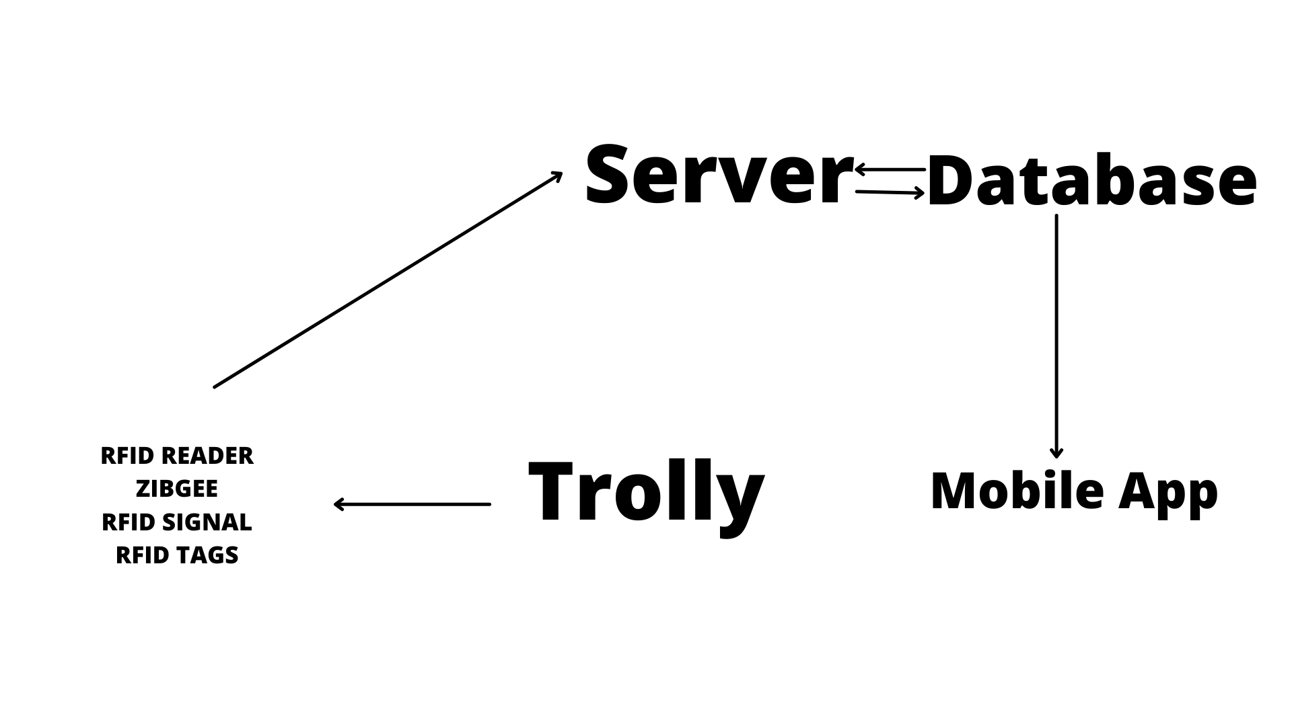
System Design

Slide 27
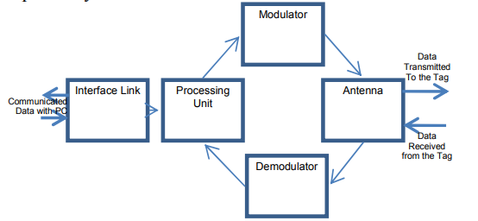
System Design - RFID READER

Slide 28
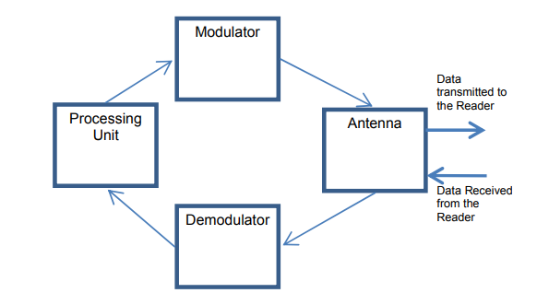
System Design - RFID TAG

Slide 29
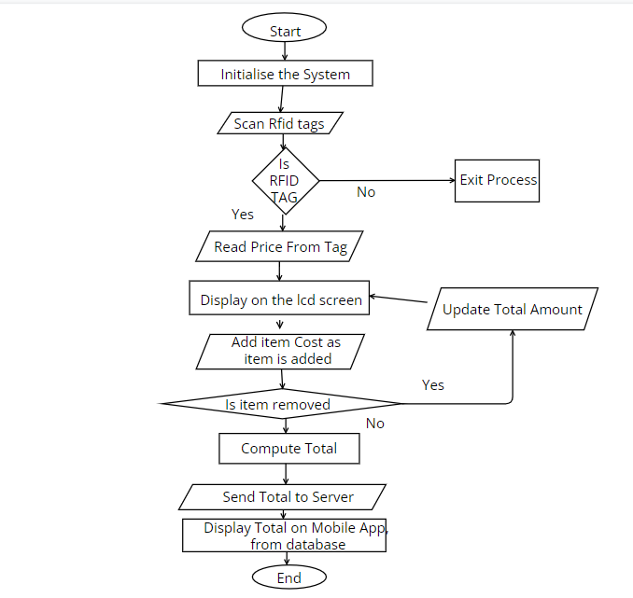
DATA FLOW DIAGRAM

Slide 30
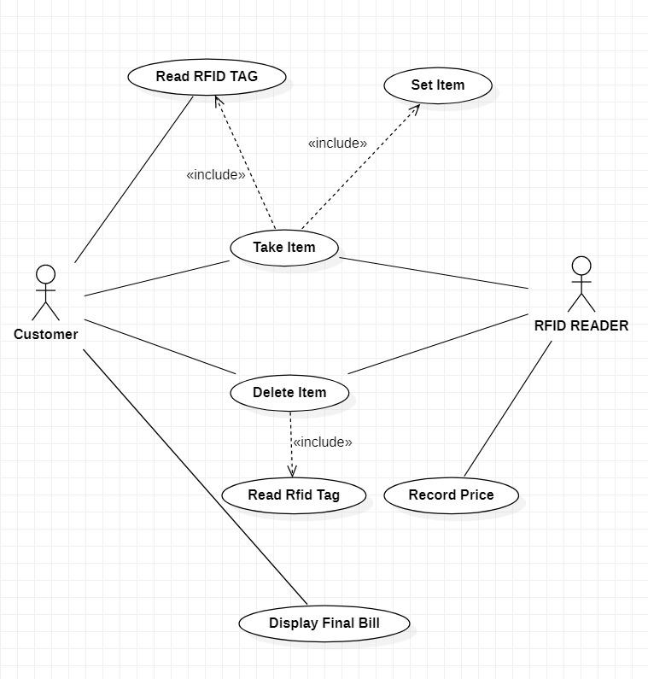
USE CASE DIAGRAM

Slide 31
Conclusion
This system provides solution to improve the speed of purchasing of products and faster payment option.
This offers a technology oriented, low-cost, easily scalable, and rugged system for assisting shopping in person.
No ‘line of sight’ is required in case of RFID that reduces the labor required to scan the product and allowing more proactive, real time tracking.

Slide 32
References
[1] Applications on Secure Smart Shopping System Suhas B.M1, Tanu.N.Prabhu2.
International Research Journal of Engineering and Technology (IRJET) e-ISSN: 2395-0056 Volume: 05 Issue: 02 | Feb-2018
[2] 2018, Purva S. Puranik1 , Parikshit N. Mahalle2 IoT Application on Smart and Secure Shopping System using RFID, Zig-Bee and Gossamer Protocol. International Journal of Engineering and Techniques - Volume 4 Issue 3, May - June 2018
[3] SMART SHOPPING TROLLEY USING RFID P.T. Sivagurunathan# ,P. Seema*, M. Shalini*.
International Journal of Pure and Applied Mathematics Volume 118 No. 20 2018,
[4] Binary search algorithm of RFID system in the supermarket shopping information identification.
Wu et al. EURASIP Journal on Wireless Communications and Networking (2019) 2019:27
[5] Smart Cart For Automatic Billing With Integrated Rfid System Shaikh Farhan Shahnoor1 , Ravi Kumar2 , Manish Rathore3 , Shivashish Saha4 , Raji C. Turkish Journal of Computer and Mathematics Education V ol.12 No.12 (2021), 2487-2493 Research Article 2487

Slide 33
References
[6] Vallabhuni, R.R., Lakshmanachari, S., Avanthi, G. and Vijay, V., 2020, December. Smart Cart Shopping System with an RFID Interface for Human Assistance. In 2020 3rd International Conference on Intelligent Sustainable Systems (ICISS) (pp. 165-169). IEEE.
[7] Athauda, T., Marin, J.C.L., Lee, J. and Karmakar, N.C., 2018. Robust low-cost UHF RFID based smart shopping trolley. IEEE journal of radio frequency identification, 2(3), pp.134-143.
[8] Li, R., Song, T., Capurso, N., Yu, J., Couture, J. and Cheng, X., 2017. IoT applications on secure smart shopping system. IEEE Internet of Things Journal, 4(6), pp.1945-1954.
[9] Nithiavathy, R., Shree, R.A., Kumar, S.P. and Raghul, S., 2021, May. Arduino enabled IoT based Smart Shopping Trolley. In Journal of Physics: Conference Series (Vol. 1916, No. 1, p. 012203). IOP Publishing.
[10] Ballestín, F., Pérez, Á., Lino, P., Quintanilla, S. and Valls, V., 2019. Static and dynamic policies with RFID for the scheduling of retrieval and storage warehouse operations. Computers & Industrial Engineering, 66(4), pp.696-709.

Slide 34
References
[11] M. Shahroz, M. F. Mushtaq, M. Ahmad, S. Ullah, A. Mehmood and G. S. Choi, "IoT-Based Smart Shopping Cart Using Radio Frequency Identification," in IEEE Access, vol. 8, pp. 68426-68438, 2020, doi: 10.1109/ACCESS.2020.2986681.
[12] P. Chandrasekar and T. Sangeetha, "Smart shopping cart with automatic billing system through RFID and ZigBee," International Conference on Information Communication and Embedded Systems (ICICES2014), 2014, pp. 1-4, doi: 10.1109/ICICES.2014.7033996.
[13] R. Li, T. Song, N. Capurso, J. Yu, J. Couture and X. Cheng, "IoT Applications on Secure Smart Shopping System," in IEEE Internet of Things Journal, vol. 4, no. 6, pp. 1945-1954, Dec. 2017, doi: 10.1109/JIOT.2017.2706698.
[14] T. Athauda, J. C. L. Marin, J. Lee and N. C. Karmakar, "Robust Low-Cost Passive UHF RFID Based Smart Shopping Trolley," in IEEE Journal of Radio Frequency Identification, vol. 2, no. 3, pp. 134-143, Sept. 2018, doi: 10.1109/JRFID.2018.2866087.
[15] S. Mekruksavanich, "Supermarket Shopping System using RFID as the IoT Application," 2020 Joint International Conference on Digital Arts, Media and Technology with ECTI Northern Section Conference on Electrical, Electronics, Computer and Telecommunications Engineering (ECTI DAMT & NCON), 2020, pp. 83-86, doi: 10.1109/ECTIDAMTNCON48261.2020.9090714.

